Slide 1
WebDev Wireframes
Josh CJ

Slide 2
General Information
For my website I intend for it to be one long page in which there will be hyperlinks that allow the user to be able to travel down the page instantaneous to the relevant place they may want to see. I believe that this is a better way of making a website like the once I am making because everything will be in one place and the website will not have to load every time the user navigates to a new hyperlink as everything will hopefully of loaded when the user first arrives to the website.

Slide 3
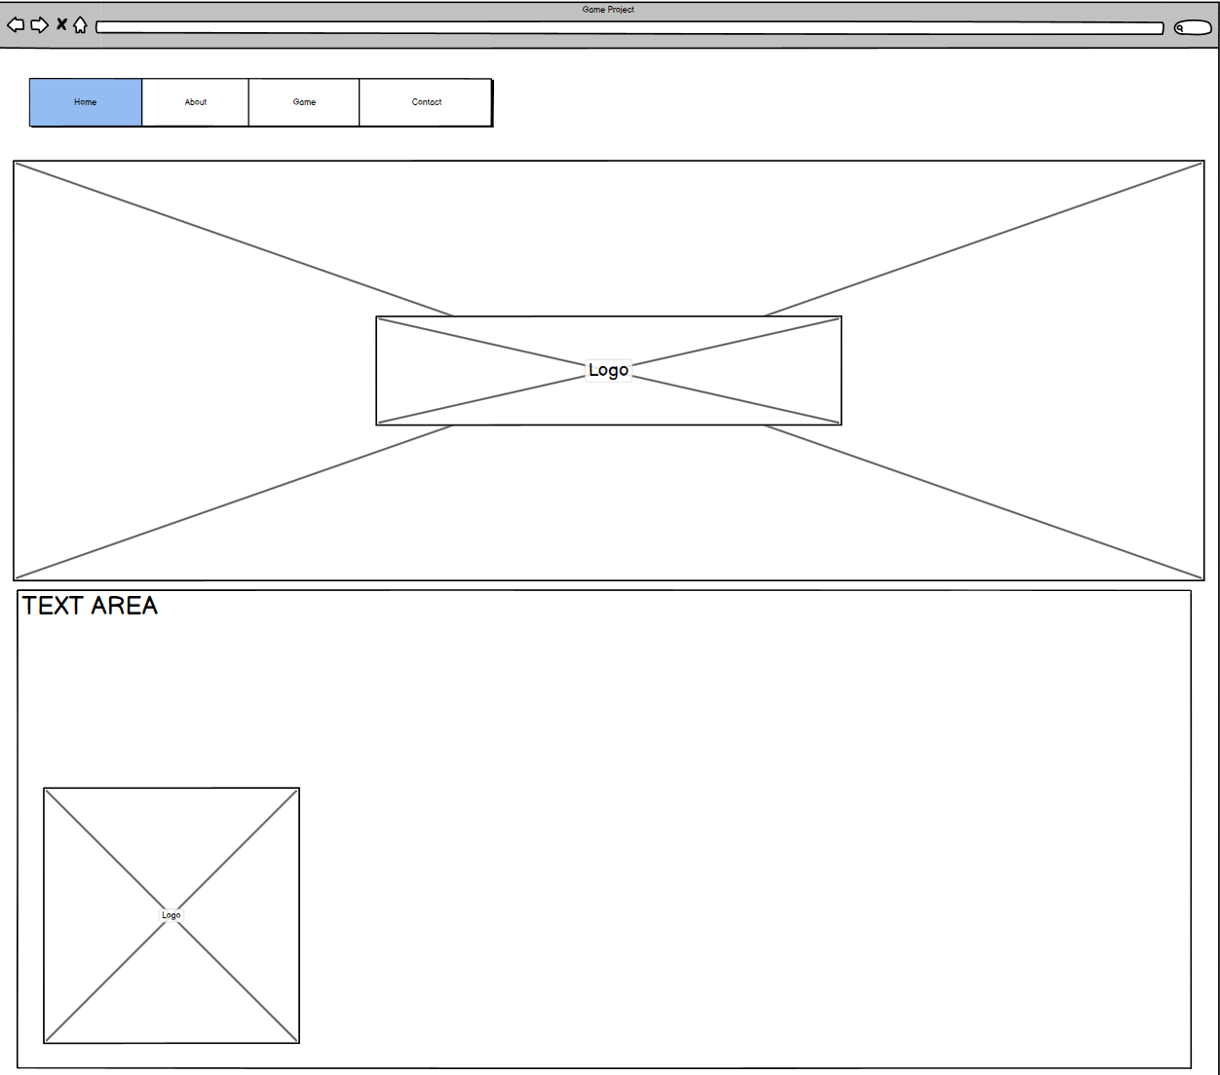



Home/About us
This is the navigation bar which will stay at the top of the screen. This will allow user to be able to instantly skip to the part of the website they are more interested by. Meaning they will not have to scroll all the way to the part they are looking for
This will be a backing image for the logo to make the website look more welcoming and richer.
This is going to be the logo for the website which will be the JCJ logo as this is the website of JCJ in which the Game/Project will feature.
This will be where a secondary logo my be present or a general image
This will be the about section which will alborate on who I am, what I am doing and speak briefly about the game I am creating

Slide 4
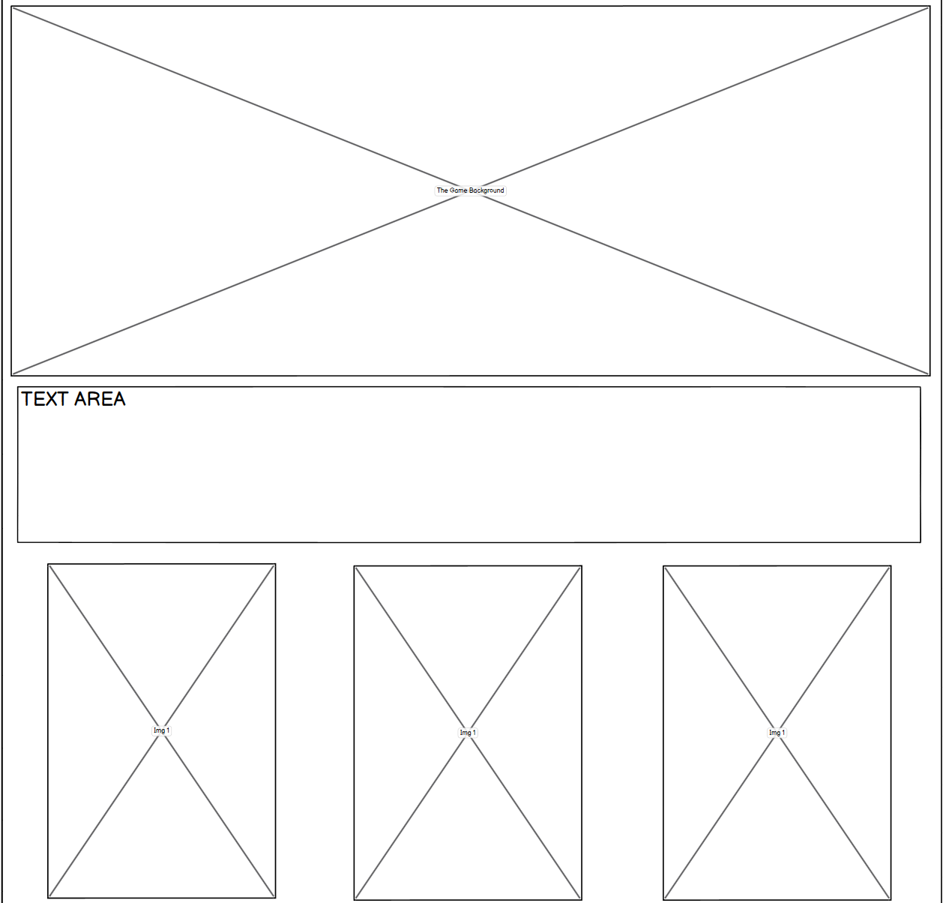

The Game
A general display image, this is to make each section look presentable
Text area to add context to each section of the website. For this section it will speak about the game that is being made, this will give info about the game and will also update users of progress towards the creation of the game
The are going to be concept images of the game and what it may potentially look like when the game is in full release. This will be Main Menu, Upgrade Menu and Gameplay

Slide 5
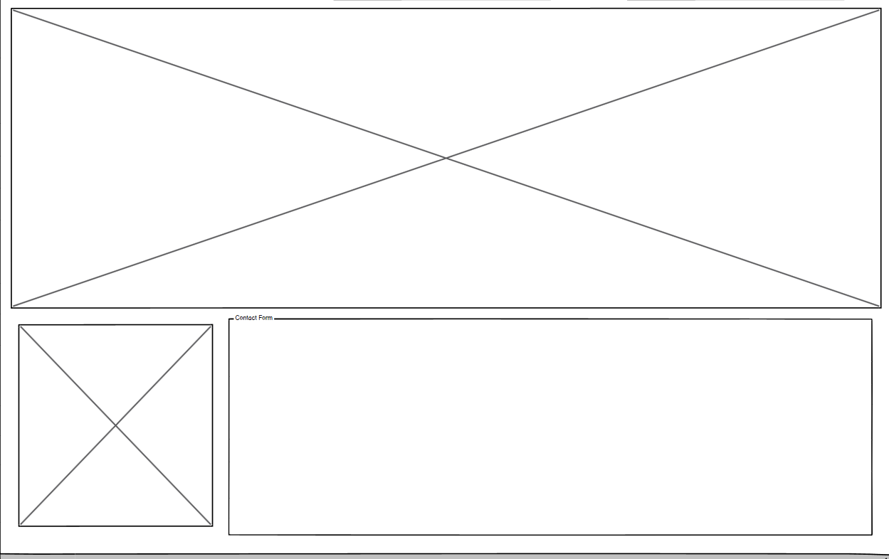



Contact Us
Once again another part of the website to make users feel more welcome and makes presenting titles look more better a plain backing
An image to give the section more content to make it look more professionally
This part will feature a form for user to be able to ask questions or to be personally be kept up to date on how the project progress is going.

